Slide 1
INTRODUCTION TO MARKETING
0
Chapter 3
The Cultural
Environment
NGUYEN THI PHUONG*
THANG LONG UNIVERSITY
*MA in Global Marketing, PHD in Economics

Slide 2
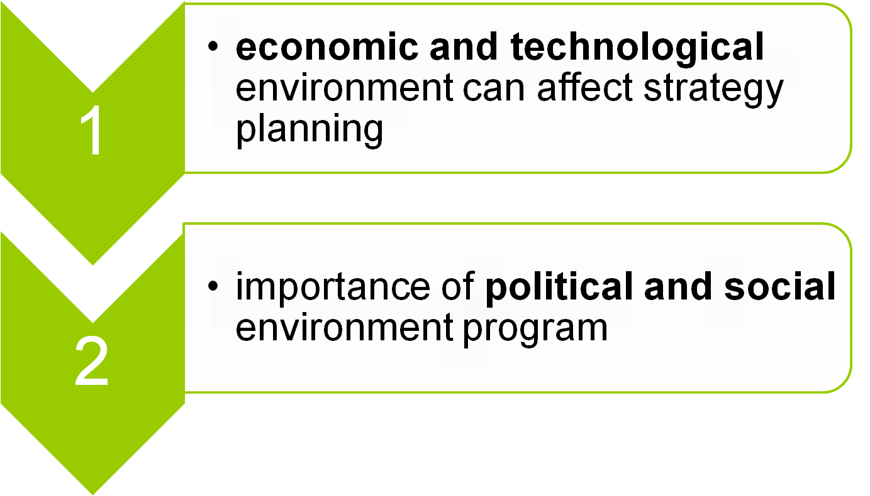
SESSION 3: Analyzing the market environment
Copyright © 2011 Pearson Education
15-<number>

Slide 3
3.1 The marketing environment
A large number of forces shape the marketing environment:
(i) direct market environment: customers, company and competitors
(ii) external market environment:
  Economic environment
  Technological environment
  Political and legal environment
  Cultural and social environment
Copyright © 2011 Pearson Education
15-<number>

Slide 4
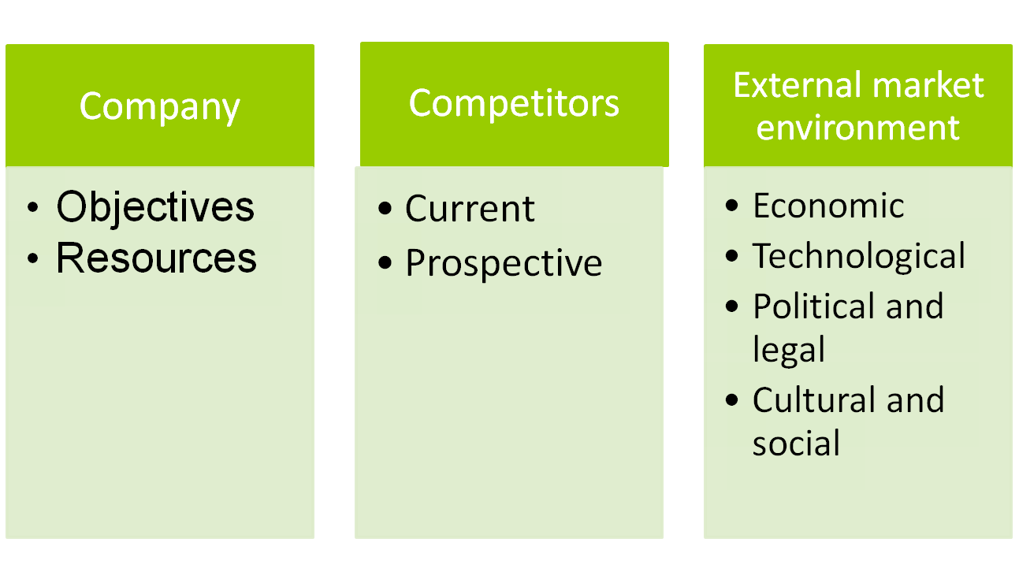
Competitors, Company and external market environment
Copyright © 2011 Pearson Education
15-<number>

Slide 5
3.2 The economic environment
Example 1: Let see what happened in Thailand in the late 1990s. In a few months, power of Thai money was cut by half.
Analyze case of Venezuela economic crisis
Example 2: The consumption of goods in Vietnam during global economic crisis 2008-09
The effects of economic environment can change consumer’s income=> firms change their patterns=> many businesses collapse or have big gains=> changes in marketing strategy
Copyright © 2011 Pearson Education
15-<number>

Slide 6
Changes in the interest rate. Interest rates usually increase during periods of inflation. When costs are rising rapidly and there are no more cost-cutting measures to take, a marketing manager have to increase prices
Changes in the exchange rate.
For example, when the dollar is strong which makes US products more expensive overseas and foreign products cheaper in US.
Copyright © 2011 Pearson Education
15-<number>

Slide 7

3.3 The technological environment
Technology affects marketing in two basic ways: with new products and with new processes
Example 1: advances in information technology allows to communicate with satellite video conferencing. Websites enable e-commerce exchanges between firms.
Example 2: explosion of high-tech products
Copyright © 2011 Pearson Education
15-<number>

Slide 8
Technological change opens up new opportunities but it also poses challenges for marketers.
Marketers often must help their firms decide what technology development is ethically acceptable
For example, many firms track information of customers and sell this information to whoever wants to use it to send promotional e-mail. Who are they???
Copyright © 2011 Pearson Education
15-<number>

Slide 9
3.4 The political and legal environment
Political environment can also affect opportunities at a local or international level. Political dimensions:
Nationalism is known as an emphasis on a country’s interests before everything else
Example: China has made it difficult for outside firms to do business
Regional groupings
Example: unification of Europe and free trade among the nations of North America are examples of regional grouping
Copyright © 2011 Pearson Education
15-<number>
Notes:
chủ nghĩa dân tộc
Các nhóm khu vực
Chủ nghĩa tiêu dùng

Slide 10
Consumerism is social movement that seeks to increase the rights and powers of consumers
Example: Consumers staged frequent boycotts and protest marches and attracted much media attention=> need safety standards
Legal environment
consumer protection
product safety
food and drugs are controlled
local law
Copyright © 2011 Pearson Education
15-<number>

Slide 11
3.5 Cultural and social environment
Cultural and social environment affects customer buying behavior and eventually economic, political and legal environment.
Variables make up the cultural and social environment:
languages
education
religious beliefs
what type of food
style of clothing, etc
Copyright © 2011 Pearson Education
15-<number>

Slide 12
Different subgroups of people may be affected by the cultural and social environment in different ways
The trend toward multiculturalism is making such differences even more important to marketers=> require special attention when segmenting markets.
Copyright © 2011 Pearson Education
15-<number>

Slide 13
Homework
1. Analyzing the external market environment (PEST) of Starbuck when entering Vietnam market
Copyright © 2011 Pearson Education
15-<number>

